Slide 1
Clustering using DBSCAN
Density-Based Spatial Clustering of Applications with Noise

Slide 2
Contents
01
02
Introduction to DBSCAN
Why DBSCAN is Powerful
03
04
DBSCAN Parameters
Core, Border, and Noise Points
05
06
DBSCAN Algorithm – Step by Step
Output of DBSCAN
07
08
How DBSCAN Forms Clusters
DBSCAN vs K-Means

Slide 3
Clustering – Quick Recap
Unsupervised Learning
Clustering is an unsupervised learning technique that works without predefined labels or supervision.
Grouping Data Points
Groups similar data points together based on their characteristics and relationships.
Pattern Discovery
Goal: discover natural structure and patterns hidden within the data.

Slide 4
Why Another Clustering Algorithm?
The K-means method is most commonly used method but at times may not provide a clear cluster solution. Some of the drawbacks
of K-means method ate:
Predefined Clusters
Requires number of clusters upfront, which is often unknown in practice.
Shape Assumptions
Assumes spherical clusters, which may not match real data distributions.
Noise Sensitivity
Sensitive to noise and outliers, leading to poor clustering results.
Real-world data rarely behaves this nicely

Slide 5
Introduction to DBSCAN
Key Insight
DBSCAN groups points based on data density, not distance to centroids. This fundamental shift in approach allows for more flexible and realistic clustering.
Core Idea
Density-based clustering mirrors how humans naturally identify groups in spatial data.
Clusters are dense regions separated by sparse regions. The algorithm identifies areas where points are tightly packed together and treats sparse areas as boundaries or noise.

Slide 6
Why DBSCAN is Powerful
Automatic Cluster Detection
Automatically detects number of clusters without requiring prior specification.
Arbitrary Shapes
Can find arbitrarily shaped clusters, not limited to spherical or convex shapes.
Explicit Noise Identification
Identifies noise and outliers explicitly, treating them as a separate category.
No Predefinition Needed
No need to specify cluster count in advance, making it ideal for exploratory analysis.

Slide 7
Typical Use Cases
Spatial & Geographical Data
Identifying geographic clusters, hotspots, and spatial patterns in location-based datasets.
Image Segmentation
Separating objects and regions in digital images based on pixel density and color.
Anomaly & Fraud Detection
Detecting unusual patterns and outliers in financial transactions and security systems.
Customer Behavior Analysis
Understanding customer segments and identifying unusual purchasing patterns.

Slide 8
DBSCAN vs K-Means
Conceptual Comparison
Aspect | DBSCAN | K-Means
Clusters | Auto-detected | Predefined
Shape | Arbitrary | Spherical
Noise | Explicit | Not handled
Outliers | Robust | Sensitive

Slide 9
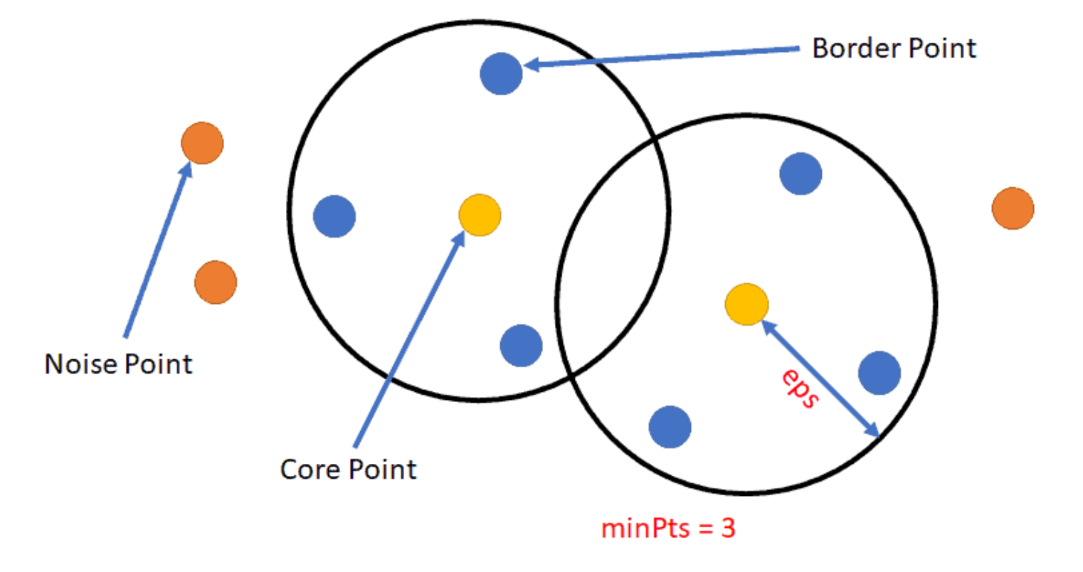
DBSCAN Parameters - Conceptual Foundation
DBSCAN defines density using two critical parameters that work together to determine what constitutes a "dense" region:
ε (Epsilon)
Radius of neighborhood around each point. Defines how far to look for neighboring points.
MinPts
Minimum number of points required to form a dense region. Defines the threshold for density.
These two values define what "dense" means in your specific dataset.

Slide 10
Core, Border, and Noise Points
Based on ε and MinPts, DBSCAN classifies every point in the dataset into one of three categories:
Core Point
Has at least MinPts points within ε (including itself). These points form the foundation of clusters and can reach other points.
Border Point
Lies within ε of a core point but has fewer than MinPts neighbors. These points are on cluster boundaries.
Noise Point
Neither core nor border → isolated. These points don't belong to any cluster and are considered outliers.

Slide 11
Why "Including Itself" Matters
In standard DBSCAN implementations (e.g., scikit-learn), the MinPts parameter includes the point itself in the count. This is a crucial detail for understanding the algorithm's behavior.
Example
If MinPts = 3, then a core point needs:
Itself (1 point)
Plus 2 neighbors
Total = 3 points
Mathematical Definition
The set includes the point x_i itself.

Slide 12
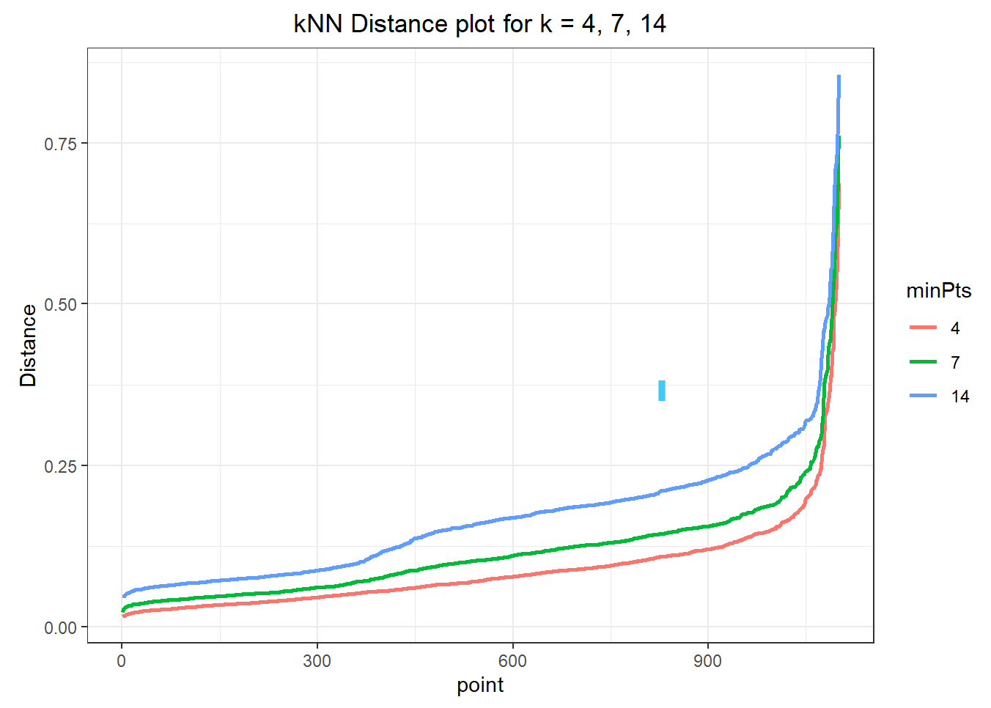
k-Nearest Neighbor Distance Plot for Selecting ε (Epsilon)
This k-NN distance plot helps us select an appropriate ε (epsilon) value for DBSCAN by locating the elbow point where distances start increasing sharply, indicating a transition from dense regions to noise.
Here, min_samples is chosen as 2 × number of features, and from the curve for k = 4, the elbow appears around ε ≈ 0.25, which can be taken as a reasonable epsilon value for DBSCAN.

Slide 13
DBSCAN Algorithm – Step by Step
Initialize
Mark all points as unvisited
Select Point
Select an unvisited point p
Find Neighbors
Find ε-neighborhood of p
Check Density
If neighbors < MinPts → label as noise
Create Cluster
Else → start a new cluster
Expand
Expand cluster using neighboring core points
Repeat
Repeat until all points are processed

Slide 14
Directly Density-Reachable
Theoretical Backbone
Point q is directly density-reachable from p if:
Condition 1
q lies within ε of p (they are neighbors)
Condition 2
p is a core point (has sufficient density)
Key Notes
Directional relationship (p → q, not necessarily q → p)
Only core points can directly reach others
Border and noise points cannot initiate reachability

Slide 15
Density-Reachable
Point q is density-reachable from p if there exists a chain of points where each step is directly density-reachable.
1. Chain Exists
There exists a sequence of points connecting p to q
2. Direct Steps
Each step in the chain is directly density-reachable
3. Core Path
All intermediate points must be core points
Key Notes
Directional relationship (not symmetric)
Border points only appear at the end of chains
Noise points are never reachable from any point

Slide 16
Density-Connected
Two points p and q are density-connected if both are density-reachable from a common core point.
Definition
There exists a core point o such that:
p is density-reachable from o
q is density-reachable from o
Importance
This symmetric relationship defines cluster membership. All points in a cluster are density-connected to each other.
Critical Property
Unlike density-reachability, density-connectivity is symmetric: if p is density-connected to q, then q is density-connected to p.

Slide 17
How DBSCAN Forms Clusters
Identify Core Points
Scan all points and identify which ones are core points based on ε and MinPts.
Start from Core
Start from an unvisited core point to begin forming a new cluster.
Add Reachable Points
Add all density-reachable points to the current cluster, expanding outward.
Maximal Set
Cluster = maximal set of density-connected points (cannot be expanded further).
Label Remaining
Remaining points that don't belong to any cluster are labeled as noise.

Slide 18
Python Implementation with scikit-learn
DBSCAN is implemented in the scikit-learn library, making it easy to apply to your datasets.
from sklearn.cluster import DBSCAN
from sklearn.preprocessing import StandardScaler
# Preprocessing: Scale features
scaler = StandardScaler()
X_scaled = scaler.fit_transform(X)
# Initialize and fit DBSCAN
dbscan = DBSCAN(eps=0.5, min_samples=5, metric='euclidean')
labels = dbscan.fit_predict(X_scaled)

Slide 19
Key DBSCAN Parameters
eps (ε)
The maximum distance between two points for them to be considered neighbors. This is the most critical parameter to tune.
min_samples (MinPts)
The minimum number of points required to form a dense region (core point). Includes the point itself.
metric
The distance metric to use. Default is 'euclidean', but 'manhattan', 'cosine', and others are supported.

Slide 20
Preprocessing Requirements
Feature Scaling
Essential: Always scale your features before applying DBSCAN. Use StandardScaler or MinMaxScaler to ensure all features contribute equally to distance calculations.
from sklearn.preprocessing import StandardScaler
scaler = StandardScaler()
X_scaled = scaler.fit_transform(X)
Dimensionality Reduction
Optional: For high-dimensional data, consider using PCA or t-SNE to reduce dimensions before clustering. This can improve performance and visualization.
from sklearn.decomposition import PCA
pca = PCA(n_components=2)
X_reduced = pca.fit_transform(X_scaled)

Slide 21
Background & Data Snapshot
Background :
Dataset contains customer age, spending across products/services, and tenure
Customer behavior may form irregular, non-linear clusters
Goal: identify natural customer segments and detect unusual customers
Why DBSCAN?
Finds clusters of any shape (not just spherical)
No need to predefine number of clusters
Automatically identifies outliers / noise points
Data Snapshot :
Cust_ID | Age | BillAmt_Product | BillAmt_Service | BillAmt_Pre | Vintage
82078 | 49 | 81128 | 48203 | 62975 | 5
57215 | 34 | 59480 | 17263 | 23634 | 5
66970 | 58 | 65363 | 30661 | 45889 | 6
77319 | 48 | 84073 | 47181 | 43186 | 7
29564 | 26 | 10541 | 3551 | 12753 | 1

Slide 22
Cluster Membership
DBSCAN assigned each customer to a cluster label stored in the Cluster column
We obtained 11 customer clusters (0 to 10) and one Noise group (-1)
Interpretation:
Cluster IDs (0–10): Customers with similar age, spending, and tenure patterns
Cluster = -1 (Noise): Customers who do not fit into any dense group
→ may represent outliers, rare
behavior, or special cases
Cust_ID | Age | BillAmt Product | BillAmt Service | BillAmt_Pre | Vintage | Cluster
82078 | 49 | 81128 | 48203 | 62975 | 5 | -1
57215 | 34 | 59480 | 17263 | 23634 | 5 | 0
66970 | 58 | 65363 | 30661 | 45889 | 6 | -1
77319 | 48 | 84073 | 47181 | 43186 | 7 | -1
29564 | 26 | 10541 | 3551 | 12753 | 1 | 1
40744 | 30 | 54889 | 17371 | 32344 | 3 | 2
20456 | 28 | 10927 | 4281 | 13746 | 1 | 1
50315 | 40 | 49047 | 18509 | 23435 | 2 | 3
54708 | 30 | 42587 | 14190 | 36112 | 4 | 4
19929 | 26 | 17964 | 4856 | 14794 | 1 | 1

Slide 23
Output Interpretation : Cluster-level Descriptive Statistics
The data was aggregated at the cluster level to compute average demographic and billing metrics for each segment.
Cluster | Count | Age | BillAmt_Product | BillAmt_Service | BillAmt_Pre | Vintage
-1 | 8005 | 54.58 | 81339.83 | 39485.53 | 54607.50 | 6.43
0 | 1983 | 37.39 | 42591.61 | 16047.36 | 30203.09 | 5.00
1 | 8035 | 26.99 | 12577.03 | 3769.15 | 12508.37 | 1.00
2 | 2089 | 37.30 | 42371.22 | 16070.94 | 30136.18 | 3.00
3 | 1893 | 37.28 | 42920.43 | 16008.61 | 29959.15 | 2.00
A total of four clusters were identified, while Cluster −1 corresponds to noise points that do not belong to any specific cluster.

Slide 24
Advantages of DBSCAN
1. No Cluster Count Required
Unlike K-Means, you don't need to specify the number of clusters beforehand, making it ideal for exploratory data analysis.
3. Robust to Outliers
Explicitly identifies and separates noise points, preventing outliers from distorting cluster formation.
2. Handles Complex Shapes
Can identify clusters of arbitrary shapes, including non-convex and intertwined patterns that K-Means cannot detect.
4. Density-Based Logic
Uses a natural, intuitive concept of density that aligns with how humans perceive groups in spatial data.

Slide 25
Key Takeaways
Density-Based Clustering
DBSCAN groups points based on density, identifying clusters as dense regions separated by sparse areas.
Two Parameters
ε (epsilon) and MinPts define what constitutes a dense region in your dataset.
Three Point Types
Core points, border points, and noise points form the foundation of the algorithm's classification.
Theoretical Concepts
Directly density-reachable, density-reachable, and density-connected define how clusters are formed mathematically.
Practical Advantages
Automatic cluster detection, arbitrary shapes, and explicit noise handling make DBSCAN powerful for real-world applications.

